Slide 1
Chapter 6
Stochastic Processes

Slide 2
What is a Stochastic Process?
Stochastic Process: is a family of random variables {X(t) | t ε T} (T is an index set; it may be discrete or continuous)
Values assumed by X(t) are called states.
State space (I): set of all possible states
Sometimes called a random process or a chance process
Notes:
If x and y are mutually independent, then, p(y|x) = p(y).

Slide 3
Stochastic Process Characterization
At a fixed time t=t₁, we have a random variable X(t₁). Similarly, we have X(t₂), .., X(t_{k}).
Discrete and continuous cases:
  States X(t) (i.e. time t) may be discrete/continuous
  State space I may be discrete/continuous

Slide 4
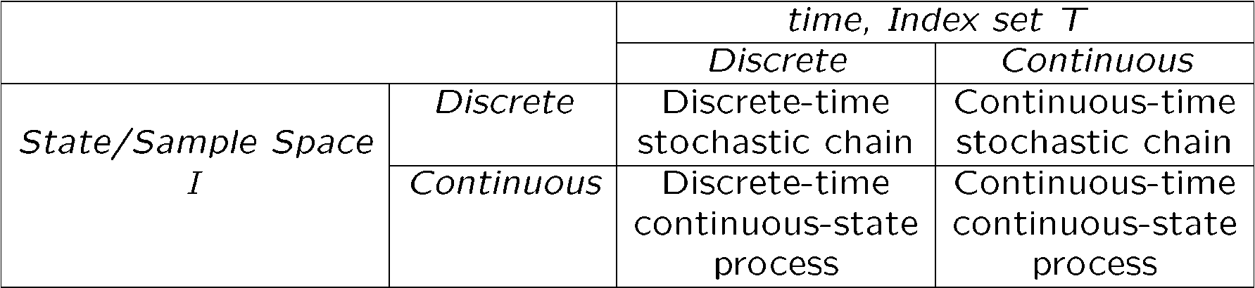
Classification of Stochastic Processes
Four classes of stochastic processes:
discrete-state process → chain
discrete-time process → stochastic sequence {X_{n} | n є T} (e.g., probing a system every 10 ms.)

Slide 5
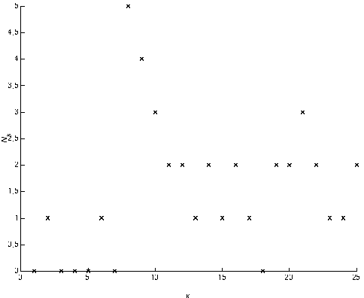
Discrete/Continuous Stochastic Processes
N_{k}: Number of jobs waiting in the system at the time of k^{th} job’s departure → Stochastic process {N_{k}| k=1,2,…}:
  Discrete time, discrete state
N_{k}
Discrete
Discrete
k

Slide 6
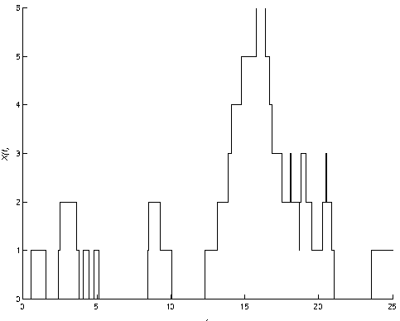
Continuous Time, Discrete Space
X(t): Number of jobs in the system at time t. {X(t) | t є T} forms a continuous-time, discrete-state stochastic process, with,
X(t)
Discrete
Continuous

Slide 7
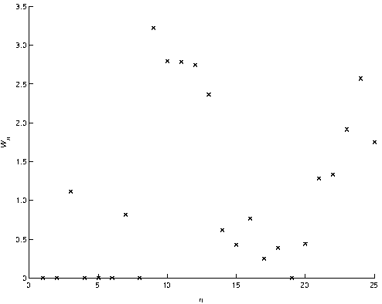
Discrete Time, Continuous Space
W_{k}: waiting time for the k^{th} job. Then {W_{k} | k є T} forms a Discrete-time, Continuous-state stochastic process, where,
W_{k}
Continuous
Discrete
k

Slide 8
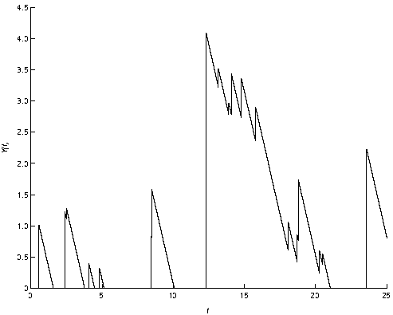
Continuous Time, Continuous Space
Y(t): total service time for all jobs in the system at time t. Y(t) forms a continuous-time, continuous-state stochastic process, Where,
Y(t)
t

Slide 9
Further Classification
  Strictly Stationary Process:
  Independent Process:
  Renewal Process:
  Markov Process:
    Stochastic proc. {X(t) | t є T} is Markov if for any t₀ < t₁< … < t_{n}< t, the conditional distribution satisfies the Markov property:
Formal Definition: Pp. 275 (Ref. Book of Kishor S. Trivedi)
Notes:
Stationary: E[x(t)] = E[x] → ensemble average. When the pdf or the CDF exhibits stationarity property, then, the process is said to strictly stationary. If only the first moment satisfies this property, then, the process is said to stationary in the mean etc.

Slide 10
Markov Process
Future states are independent of the past and depend only on the present.
Named after A. A. Markov who defined and analyzed
them in 1907.
Markov Chain: discrete state Markov process
Markov  It is not necessary to know how long the process has been in the current state State time has a memoryless (exponential) distribution.
M/M/s queues can be modeled using Markov processes
The time spent by a job in such a queue is a Markov process and the number of jobs in the queue is a Markov chain.

Slide 11
Markov Process
In some situations, a Markov chain may also exhibit time-homogeneity, i.e.,

Slide 12
Poisson Process
A continuous time, discrete state process.
N(t): no. of events occurring in time (0, t]. Events may be,
  # of packets arriving at a router port
  # of incoming telephone calls at a switch
  # of jobs arriving at file/compute server
  Number of component failures

Slide 13

Poisson Process
Events occurs successively and that intervals between these successive events are iid (independent and identically distributed), each following the exponential distribution:
  λ: arrival rate (1/ λ: average time between arrivals)
  λ: failure rate (1/ λ: average time between failures)
The standard assumption in many queuing models is that the arrival process is Poisson.

Slide 14
Birth-Death Processes
λ₀
λ₁
λ₂
λ_{j−1}
λ_{j}
λ_{j+1}
0
1
2
…
j-1
j
j+1
μ₁
μ₂
μ₃
μ_{j}
μ_{j+1}
μ _{j+2}
The discrete state Markov processes in which the transitions are restricted to neighboring states only.
Process in state n can change only to state n+1 or n-1.
Example: the number of jobs in a queue with a single server and individual arrivals (not bulk arrivals)
Formal Definition: Pp. 365 (Ref. Book of Kishor S. Trivedi)

Slide 15
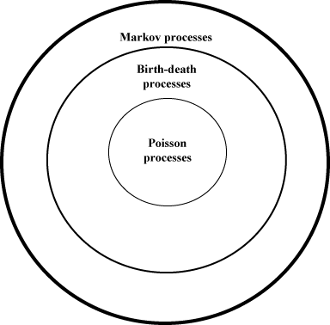
Relationship Among Stochastic Processes

Slide 16
Thank You

